Slide 1
Lecture 8:
Wavefront Sensing
Claire Max
Astro 289C, UCSC
February 4, 2020

Slide 2
Outline of lecture
General discussion: Types of wavefront sensors
Three types in more detail:
  Shack-Hartmann wavefront sensors
  Curvature sensing
  Pyramid sensing

Slide 3
At longer wavelengths, one can measure phase directly
FM radios, radar, radio interferometers like the VLA, ALMA
All work on a narrow-band signal that gets mixed with a very precise “intermediate frequency” from a local oscillator. “Heterodyne” measurement.
Very hard to do this at visible and near-infrared wavelengths
  Could use a laser as the intermediate frequency, but would need tiny bandwidth of visible or IR light
Thanks to Laird Close’s lectures for making this point

Slide 4
At visible and near-IR wavelengths, measure phase via intensity variations
Difference between various wavefront sensor schemes is the way in which phase differences are turned into intensity differences
General box diagram:
Wavefront sensor
Guide
star
Detector of Intensity
Telescope
Optics
Recon-structor
Turbulence
Transforms aberrations into intensity variations
Computer

Slide 5
How to use intensity to measure phase?
Irradiance transport equation: A is complex field amplitude, z is propagation direction. (Teague, 1982, JOSA 72, 1199)
Follow I (x,y,z) as it propagates along the z axis (paraxial ray approximation: small angle w.r.t. z)
Wavefront curvature: Curvature Sensors
Wavefront tilt: Hartmann and Pyramid sensors

Slide 6
Types of wavefront sensors
“Direct” in pupil plane: split pupil up into subapertures in some way, then use intensity in each subaperture to deduce phase of wavefront.
  Slope sensing: Shack-Hartmann, Pyramid sensing
  Curvature sensing
“Indirect” in focal plane: wavefront properties are deduced from whole-aperture intensity measurements made at or near the focal plane. Iterative methods –calculations take longer to do.
  Image sharpening
  Phase diversity, phase retrieval, Gerchberg-Saxton (these are used, for example, in JWST)
  Usually used to measure nearly static aberrations

Slide 7
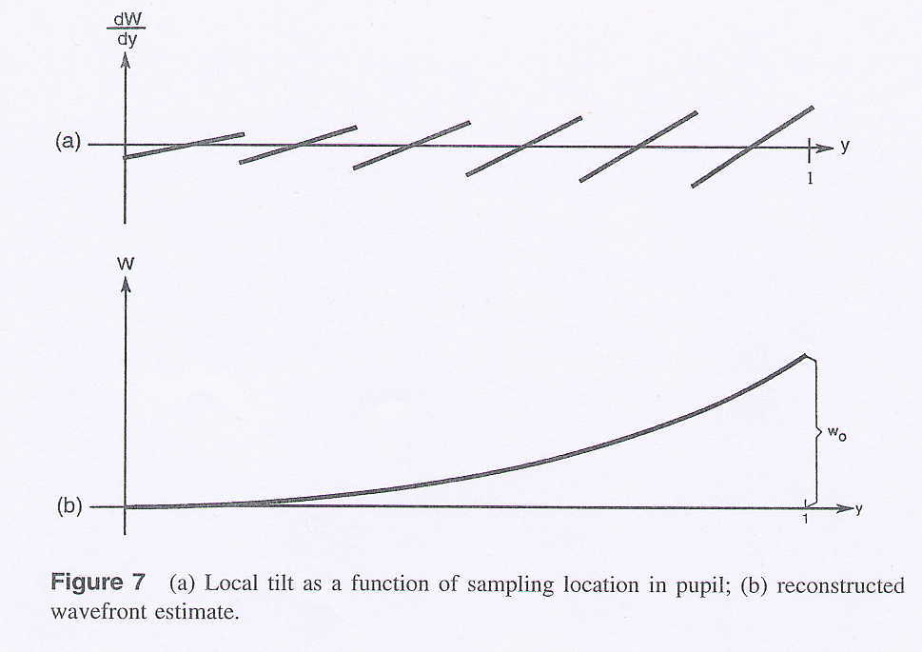
How to reconstruct wavefront from measurements of local “tilt”

Slide 8
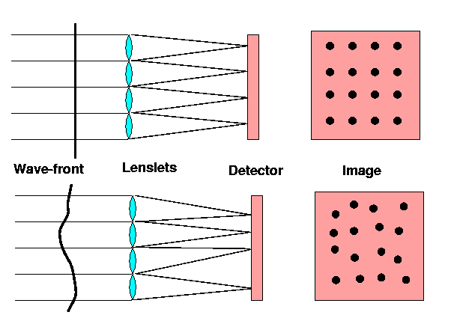
Shack-Hartmann wavefront sensor concept - measure subaperture tilts
f
Credit:
A. Tokovinin
CCD
CCD
Pupil plane
Image plane

Slide 9
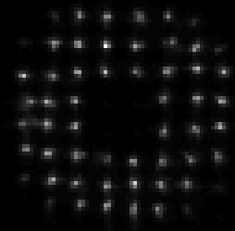
Example: Shack-Hartmann Wavefront Signals
Credit: Cyril Cavadore

Slide 10
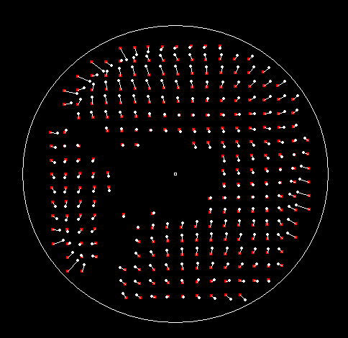
Displacement of centroids
Definition of centroid
Centroid is intensity weighted
Each arrow represents an offset proportional to its length
Credit: Cyril Cavador

Slide 11
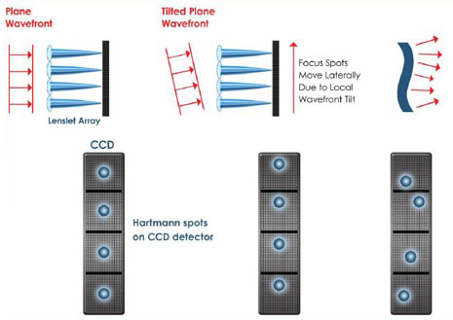
Notional Shack-Hartmann Sensor spots
Credit: Boston Micromachines

Slide 12
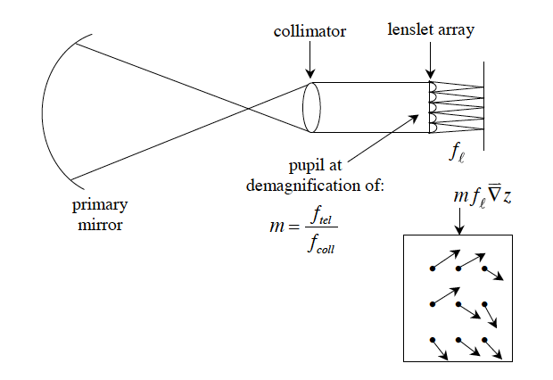
Displacement of Hartmann Spots

Slide 13
Quantitative description of Shack-Hartmann operation
Relation between displacement of Hartmann spots and slope of wavefront:
  where k = 2π / λ , Δx is the lateral displacement of a subaperture image, M is the (de)magnification of the system, f is the focal length of the lenslets in front of the Shack-Hartmann sensor

Slide 14
Credit: Marcos van Dam

Slide 15
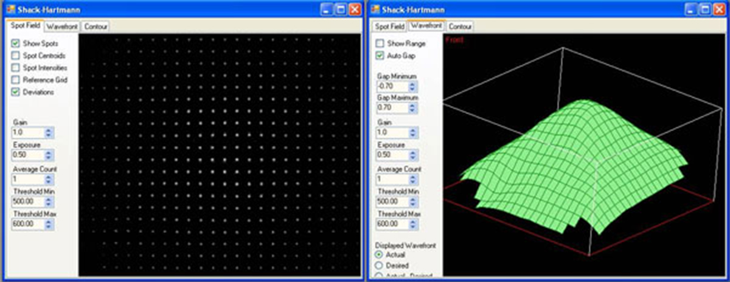
Shack-Hartmann Spots
Wavefront shape
Credit: Thorlabs

Slide 16
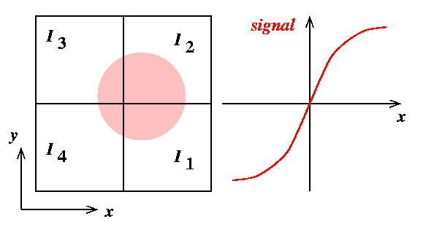
How to measure distance a spot has moved on CCD? “Quad cell formula”
b

Slide 17
Disadvantage: “gain” depends on spot size b which can vary during the night
b
Slope = 2/b

Slide 18
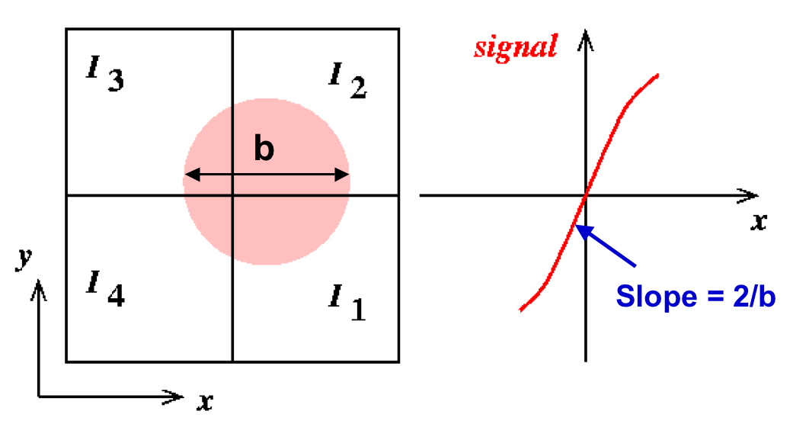
Question
What might happen if the displacement of the spot
is > radius of spot? Why?
?
?

Slide 19
Signal becomes nonlinear and saturates for large angular deviations
b
“Rollover” corresponds to spot being entirely outside of 2 quadrants

Slide 20
Measurement error from Shack-Hartmann sensing
Measurement error depends on size of spot as seen in a subaperture, θ_{b} , wavelength λ , subaperture size d, and signal-to-noise ratio SNR:
      (Hardy equation 5.16)

Slide 21
Order of magnitude, for r₀ ~ d
If we want the wavefront error to be < λ/20, we need

Slide 22
General expression for signal to noise ratio of a pixelated detector
S = flux of detected photoelectrons / subap n_{pix} = number of detector pixels per subaperture
R = read noise in electrons per pixel
The signal to noise ratio in a subaperture for fast CCD cameras is dominated by read noise, and
See McLean, “Electronic Imaging in Astronomy”, Wiley

Slide 23
Trade-off between dynamic range and sensitivity of Shack-Hartmann WFS
If spot is diffraction limited in a subaperture d, linear range of quad cell (2x2 pixels) is limited to ± λ_{ref}/2d.
Can increase dynamic range by enlarging the spot (e.g. by defocusing it).
But uncertainty in calculating centroid ∝ width x N_{ph}^{1/2} so centroid calculation will be less accurate.
Alternative: use more than 2x2 pixels per subaperture. Decreases SNR if read noise per pixel is large (spreading given amount of light over more pixels, hence more read noise).
Linear range

Slide 24
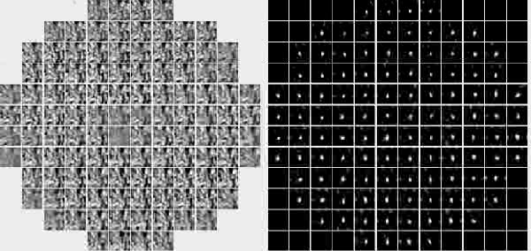
Correlating Shack-Hartmann wavefront sensor uses images in each subaperture
Solar adaptive optics: Rimmele and Marino, Solar Physics Living Reviews
Cross-correlation is used to track low contrast granulation
Left: Subaperture images, Right: cross-correlation functions
Notes:
Link is wrong

Slide 25
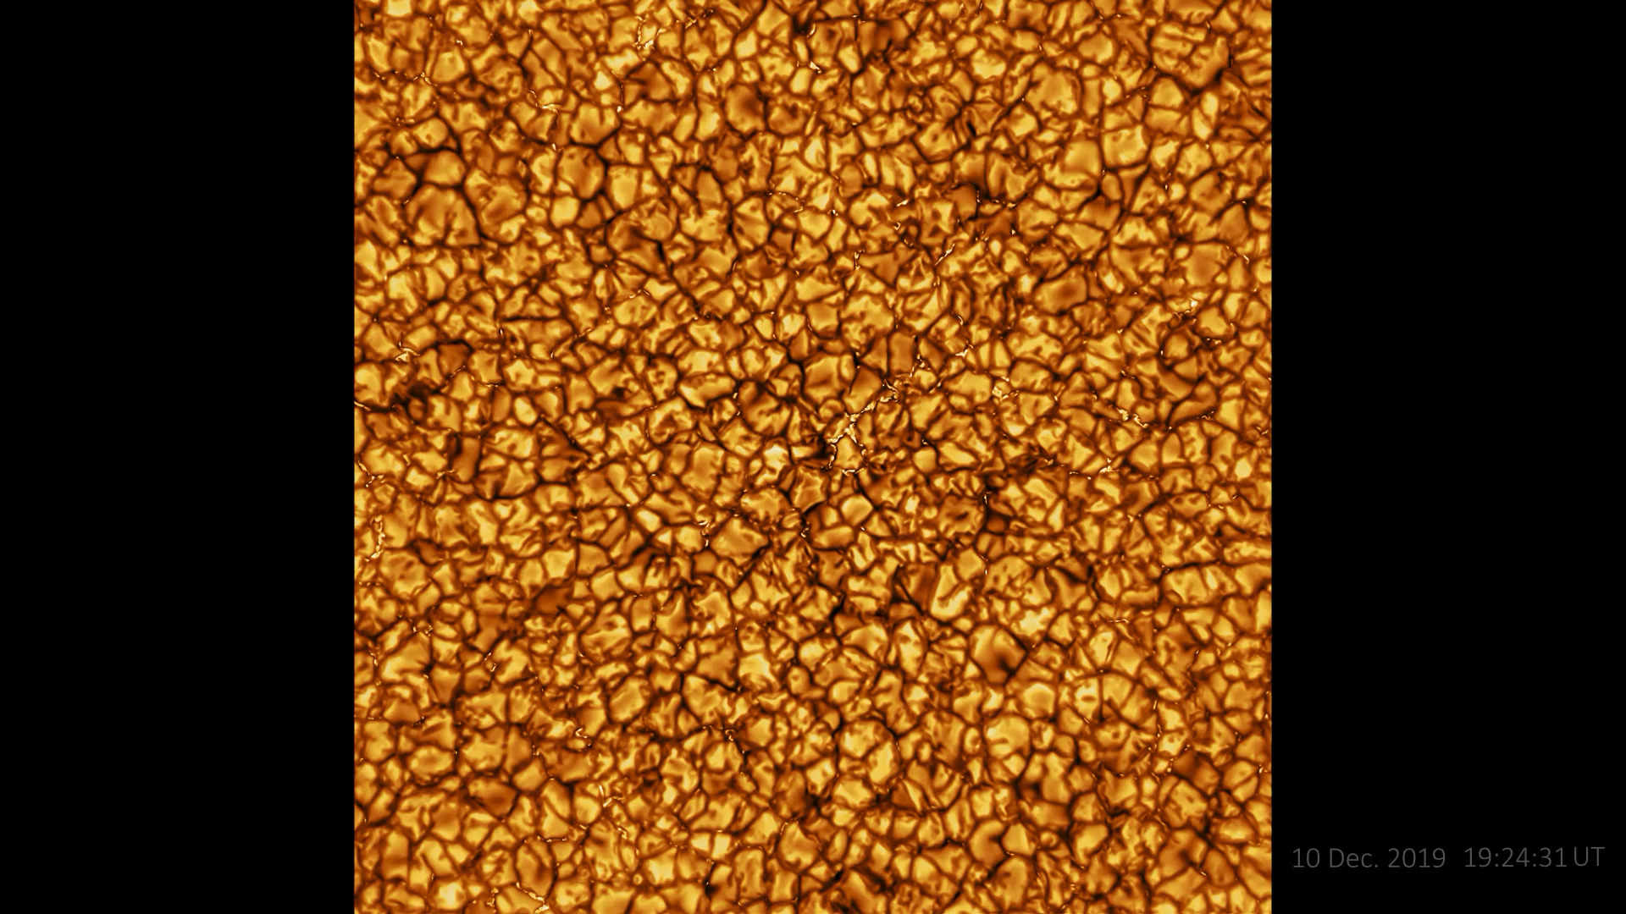
Brand new result: video of Sun from DKIST telescope, with AO

Slide 26
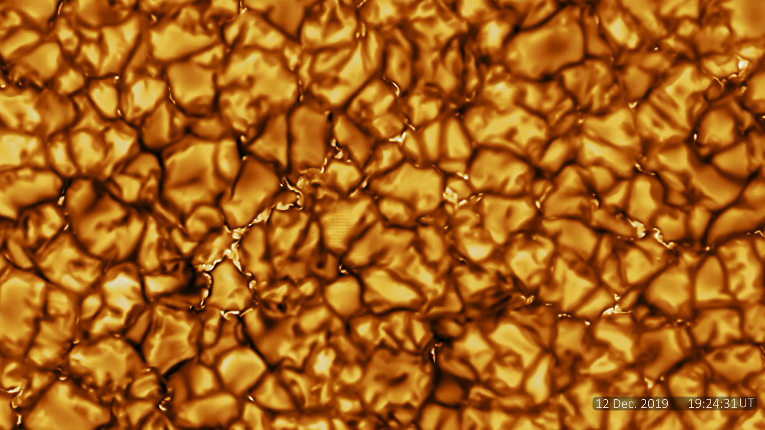
Zoomed-in Version

Slide 27
Review of Shack-Hartmann geometry
f
Pupil plane
Image plane

Slide 28
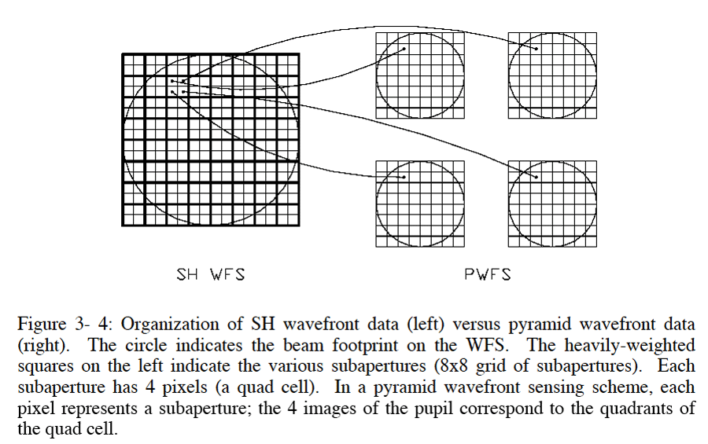
Pyramid sensor reverses order of operations in a Shack-Hartmann sensor

Slide 29
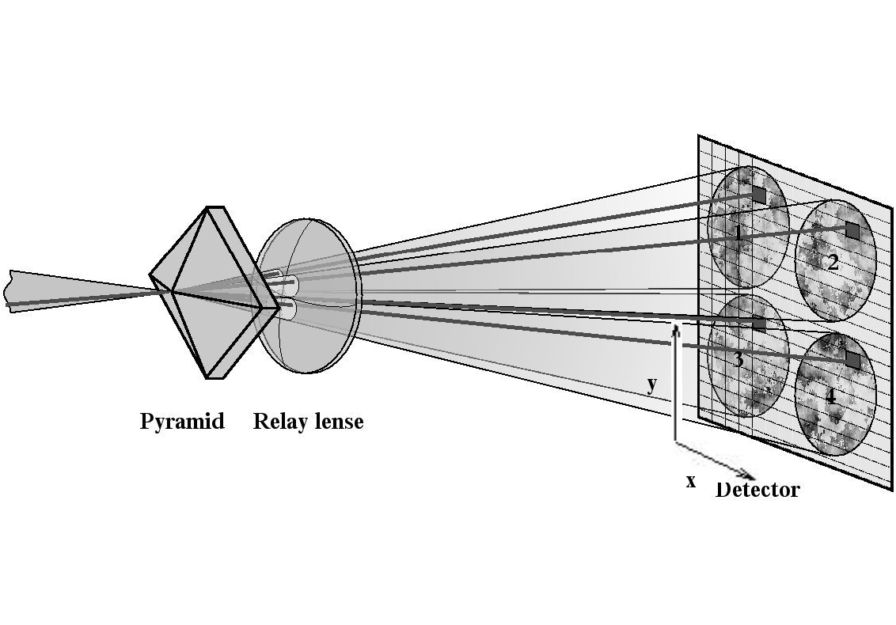
A Pyramid WFS
Stellar image is placed on the tip of a four sided pyramid --- Creates four beams.
Intermediate optics form pupil images from the four beams.
Image Plane
Pupil Plane
Credit: Sebastian Egner

Slide 30
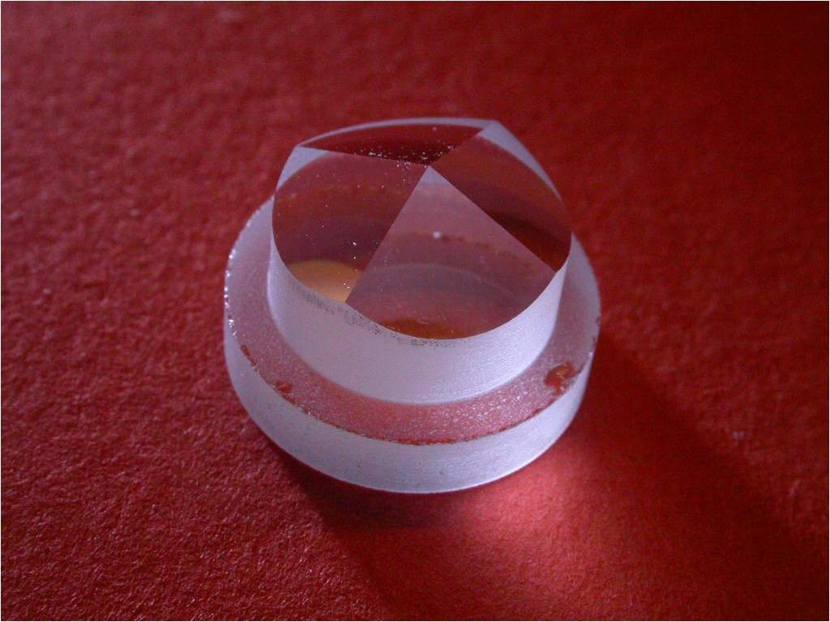
Pyramid for the William Herschel Telescope’s AO system

Slide 31
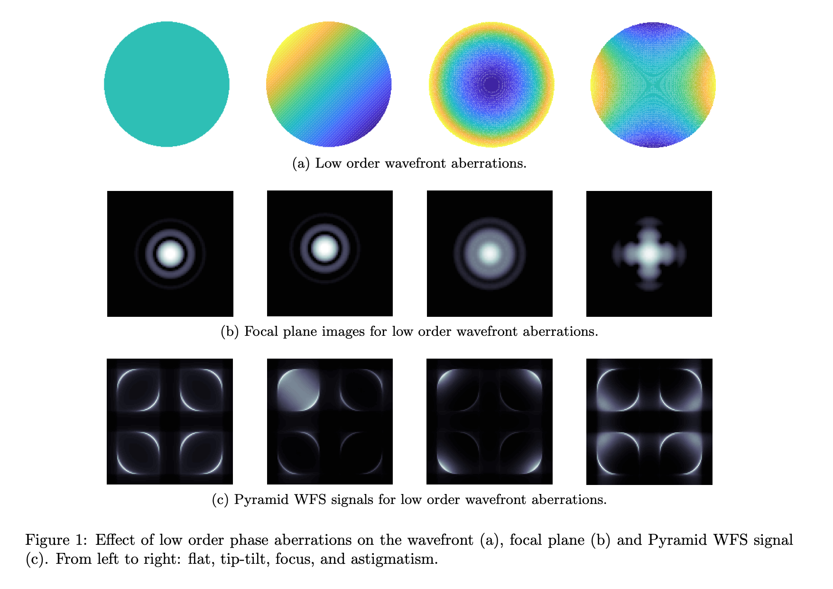
Typical intensity patterns for a
Pyramid Sensor
Credit: Charlotte Bond

Slide 32
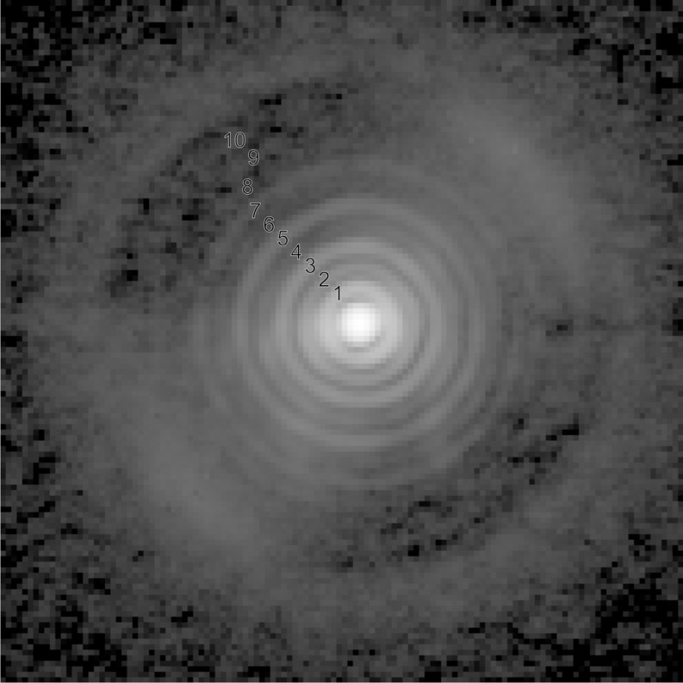
Aspects of Pyramid Sensors
More sensitive to low order modes.
  Good match to atmosphere.
  A change in sampling can easily be carried out via binning of CCD.
Pyramid Based Systems
LBT
Magellan
Subaru SCexAO
Keck IR Pyramid Sensor
Credit: Phil Hinz

Slide 33
Credit: Marcos van Dam

Slide 34
Potential advantages of pyramid wavefront sensors
Wavefront measurement error can be much lower
  Shack-Hartmann: size of spot limited to λ / d, where d is size of a sub-aperture and usually d ~ r₀
  Pyramid: size of spot can be as small as λ / D, where D is size of whole telescope. So spot can be D/r₀ = 20 - 100 times smaller than for Shack-Hartmann
  Measurement error (e.g. centroiding) is proportional to spot size/SNR. Smaller spot = lower error.
Avoids bad effects of charge diffusion in CCDs
  Fuzzes out edges of pixels.
  Pyramid doesn’t mind as much as S-H.

Slide 35
Potential pyramid sensor advantages, continued
Linear response over a larger dynamic range
Naturally filters out high spatial frequency information that you can’t correct anyway

Slide 36
Credit: Phil Hinz

Slide 37
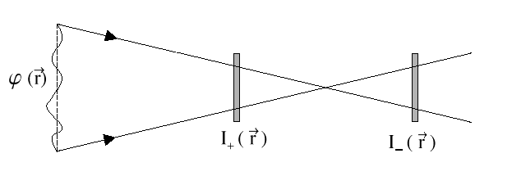
Curvature wavefront sensing
F. Roddier, Applied Optics, 27, 1223- 1225, 1998
More intense
Less intense
Normal derivative at boundary
Laplacian (curvature)

Slide 38
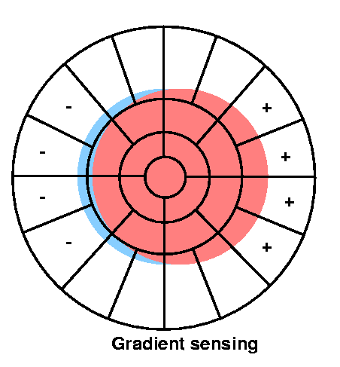
Wavefront sensor lenslet shapes are different for edge, middle of pupil
Lenslet array
Example: This is what wavefront tilt (which produces image motion) looks like on a curvature wavefront sensor
  Constant I on inside
  Excess I on right edge
  Deficit on left edge

Slide 39
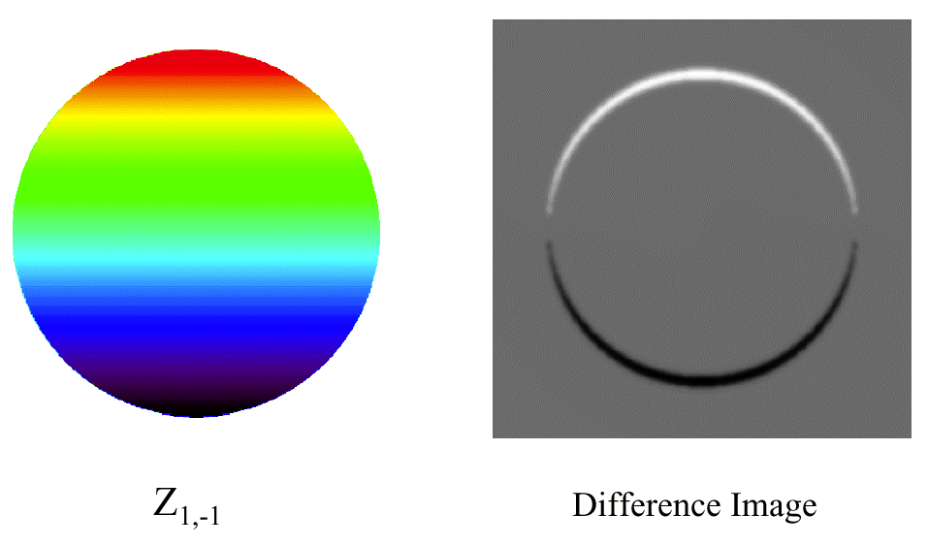
Simulation of curvature sensor response
Wavefront: pure tilt
Curvature sensor signal
Credit: G. Chanan

Slide 40
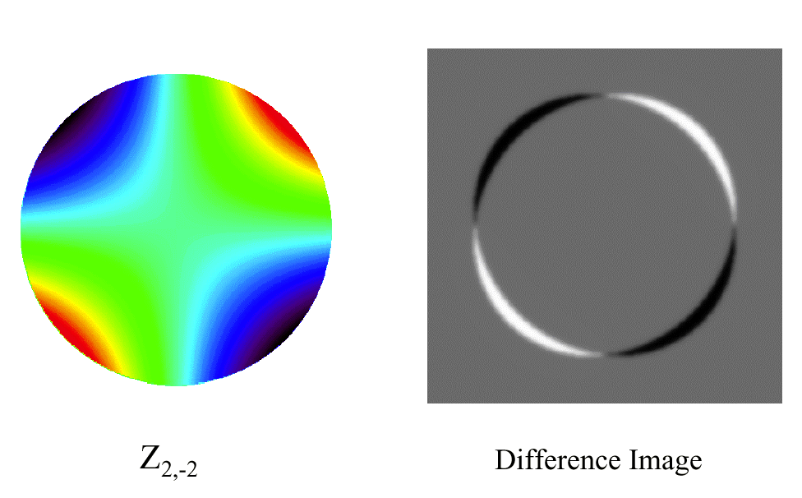
Curvature sensor signal for astigmatism
Credit: G. Chanan

Slide 41
Practical implementation of curvature sensing
More intense
Less intense
Use oscillating membrane mirror (2 kHz!) to vibrate rapidly between I₊ and I₋ extrafocal positions
Measure intensity in each subaperture with an “avalanche photodiode” (only need one per subaperture!)
  Detects individual photons, no read noise, QE ~ 60%
  Can read out very fast with no noise penalty

Slide 42
Measurement error from curvature sensing
Error of a single set of measurements is determined by photon statistics, since detector has NO read noise!
  where d = subaperture diameter and N_{ph} is no. of photoelectrons per subaperture per sample period
Error propagation when the wavefront is reconstructed numerically using a computer scales poorly with no. of subapertures N:
  (Error)_{curvature} ∝ N, whereas (Error)_{Shack-Hartmann} ∝ log N

Slide 43
Advantages and disadvantages of curvature sensing
Advantages:
  Lower noise ⇒ can use fainter guide stars than S-H
  Fast readout ⇒ can run AO system faster
  Can adjust amplitude of membrane mirror excursion as “seeing” conditions change. Affects sensitivity.
  Well matched to bimorph deformable mirror (both solve Laplace’s equation), so less computation.
  Curvature systems appear to be less expensive.
Disadvantages:
  Avalanche photodiodes can fail with too much light
  Hard to use a large number of avalanche photodiodes.
  BUT – recently available in arrays
  Doesn’t scale well to large numbers of subapertures

Slide 44
Summary of main points
Wavefront sensors in common use for astronomy measure intensity variations, deduce phase. Complementary.
  Shack-Hartmann
  Curvature sensors
Curvature systems: cheaper, fewer degrees of freedom, scale more poorly to high no. of degrees of freedom, but can use fainter guide stars
Shack-Hartmann systems excel at very large no. of degrees of freedom
Most recent addition: pyramid sensors
  Very successful for faint natural guide stars, low modes

